Slide 1

Hand sign detection using depth sensor camera
s.apurva - 16011A0403
Md.yaser ali tariq – 16011A0421
g.prabhu nithin – 16011A0431
d.sunanda - 16011A0456
Project guide : Dr. K . ANITHA SHEELA
Professor & Head of the Department ECE

Slide 2

Table of contents
Introduction
Need for sign language
Approach
Components & Software used
About Depth sensor camera
Workflow
Implementation
Results
Conclusion & scope for future work

Slide 3
Introduction
Developing sign language application for deaf people can be very important, they'll be able to communicate easily with even those who don't understand sign language.
Our project aims at taking the basic step in bridging the communication gap between normal people, deaf and dumb people using sign language.
The main focus of this work is to create a vision-based system to identify sign language gestures from the video sequences.
The reason for choosing a system based on vision relates to the fact that it provides a simpler and more intuitive way of communication between a human and a computer.

Slide 4
Need for sign language recognition:-
Sign Language recognition has emerged as one of the most important research areas in the field of human computer interaction (HCI).
The Sign Language Recognition System (SLR) is highly desired due to its ability to overcome the barrier between deaf and hearing people.
Sign languages can be used when the spoken word is physically impossible, such as talking underwater, talking through glass, from a distance, at a loud music concert, and talking with your mouth full.

Slide 5
We used the following approach for the classification of sign language postures:
approach
We performed isolated ISL posture recognition technique (numbers from 0 to 9) using RGB images & Depth Images.
The training was separately done on 3different types of data – RGB data alone, Depth data Image alone & Depth + RGB data.
A combined model is also trained by mapping RGB and Depth information into a 4d tensor.
To train the model on the spatial features we have used VGG 16 model which is a deep CNN (convolutional neural net) .
CNN was trained on individual RGB and DEPTH train data
The data set used consists of Indian Sign Language (ISL) Gestures, with around 150 images belonging to 10 gestures categories.
Using the predictions by CNN 94% accuracy was obtained on train data and 80% accuracy on test data.

Slide 6
Components & software used
Depth Sensor Camera - Primesense Carmine 1.09
Algorithms used:
Depth Calibration
Convolutional Neural Network (CNN)
Softwares used:
Open NI – Interaction with 3D-camera
Processing Language(Java) – Data acquisition
Keras (Python) – Model Training
Matlab – Data Handling

Slide 7
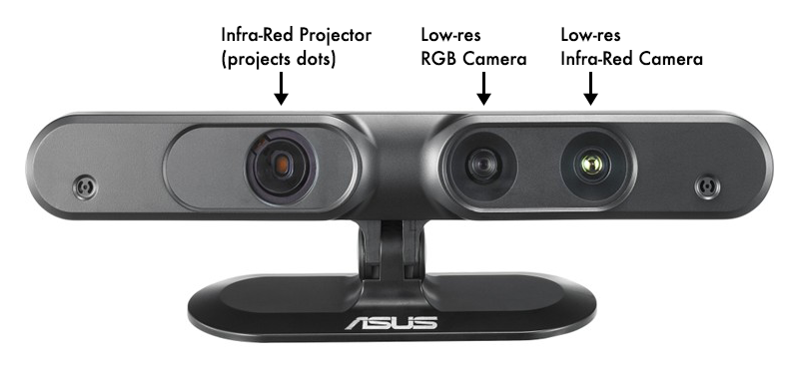
DEPTH SENSOR CAMERA ( Prime sense by ASUS):-
Prime sense Carmine 1.09 Short-range 3D Camera Sensor is for short-range scanning.
The 3D depth Sensor sees and tracks user movements within a scene .The sensor includes several optional sensory input capabilities:
Depth (3D) Image,
Color (RGB) image and
Audio
It consists of :
RGB camera
IR(Depth) camera
IR Projector

Slide 8
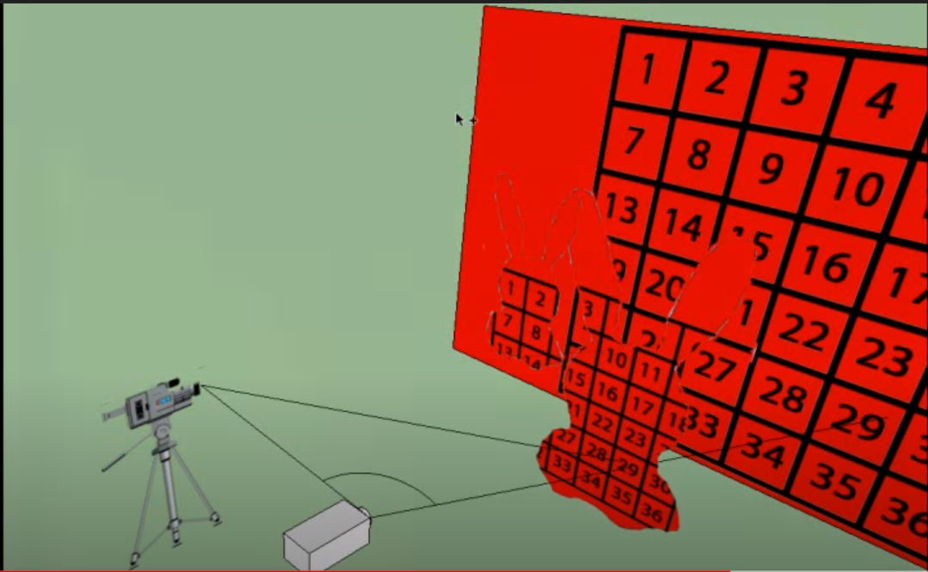
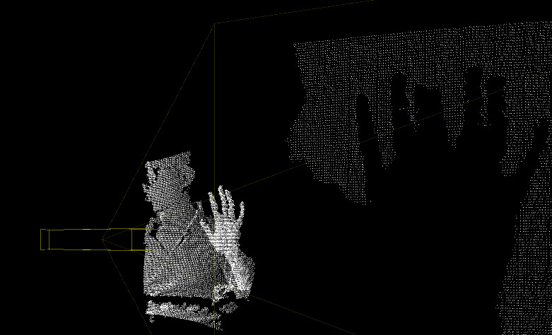
WOrking of camera:
The IR projector projects a pattern of IR light which falls on objects around it like a sea of dots.
An IR camera is essentially the same as a regular RGB camera except that the images it captures are in the Infra-Red color range.
The camera sends it's video feed of this distorted dot pattern into the depth sensor's processor, and the processor works out depth from the displacement of the dots.
On near objects the pattern is spread out, on far objects the pattern is dense.

Slide 9
Workflow
Tasks
Create a Custom Image Classifier
PrimeSense Carmine 1.09
Hardware Camera
RGB+Depth Acquistion
Building a
Data Set
Model
CNN
Open Ni Library
Frame Capture
Resources
Google Colab

Slide 10
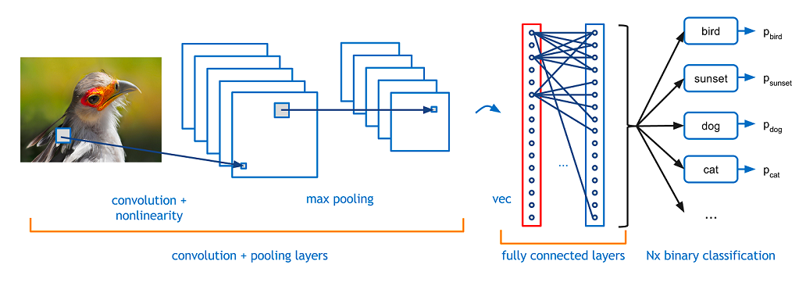
Convolutional neural network
A convolutional neural network (CNN, or ConvNet) is a type of feed-forward artificial neural network in which the connectivity pattern between its neurons is inspired by the organization of the animal visual cortex.
There are four main steps in CNN: convolution, pooling, activation and fully connectedness

Slide 11
Convolution:-The term convolution refers to both the result function and to the process of computing it. It is defined as the integral of the product of the two functions after one is reversed and shifted.
Pooling:-Pooling layers provide an approach to down sampling feature maps by summarizing the presence of features in patches of the feature map. The pooling layer summarizes the features present in a region of the feature map generated by a convolution layer.
Activation:-The activation function of a node defines the output of that node given an input or set of inputs. A standard integrated circuit can be seen as a digital network of activation functions that can be "ON" (1) or "OFF" (0), depending on input
Fully connected:-Fully Connected Layer is simply, feed forward neural networks. Fully Connected Layers form the last few layers in the network.The input to the fully connected layer is the output from the final Pooling or Convolutional Layer, which is flattened and then fed into the fully connected layer

Slide 12
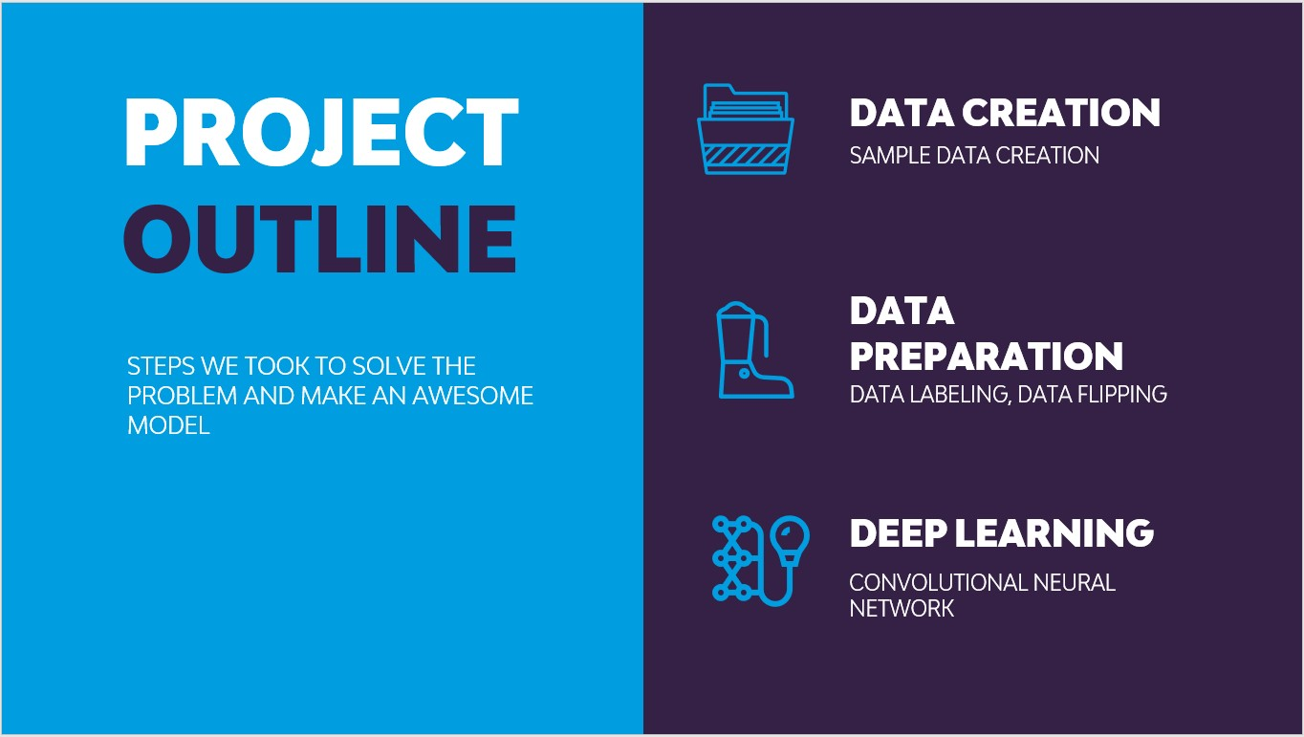
IMPLEMENTATION
1.Data Acquisition :
For our project we have created Sign Language Numbers data set consisting of 10 classes each with 15 samples. The classes correspond to hand sign gestures from 0 to 9 thereby totaling to 10 classes.
The training was completely done in a cloud platform that provided GPU acceleration for faster computations. The training was separately done on 2 different types of data – RGB alone & Depth + RGB.
For RBG alone we used the defined VGG16 network architecture.
For RGB+Depth we used a custom defined network architecture.

Slide 13
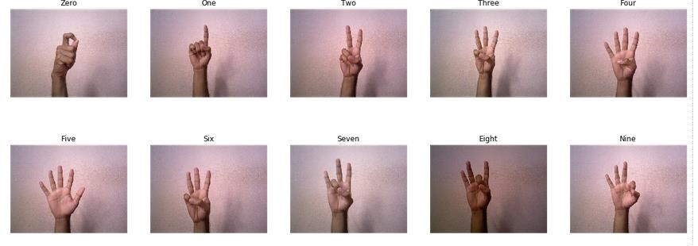
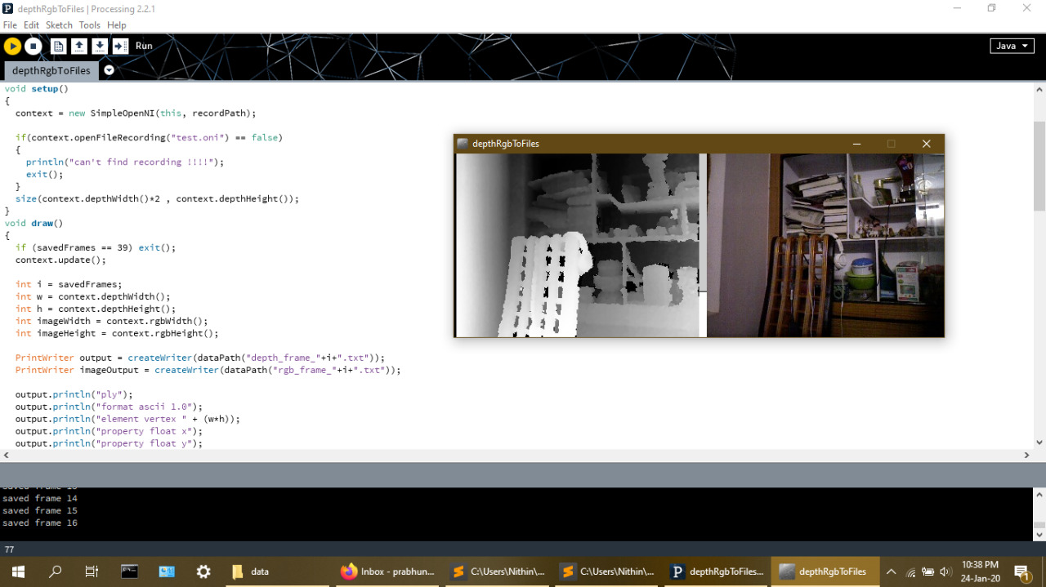
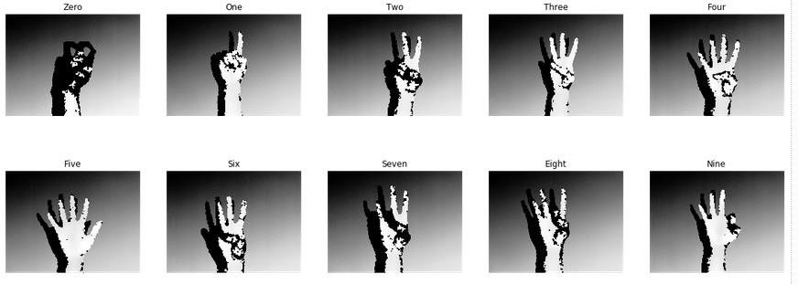
IMAGES OBTAINED FROM 3D - CAMERA
RGB-IMAGES
DEPTH-IMAGES
Processing(JAVA)

Slide 14
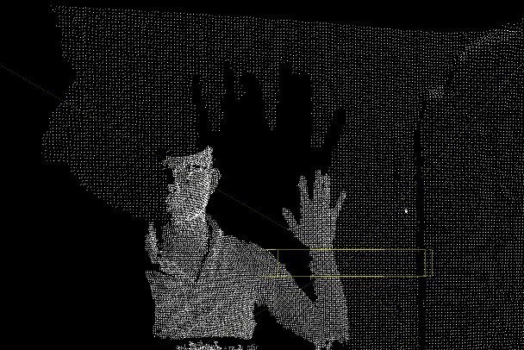
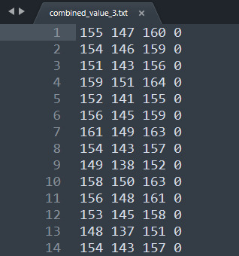
2.Data Preparation
Sample Depth Image
RGB + Depth Data

Slide 15
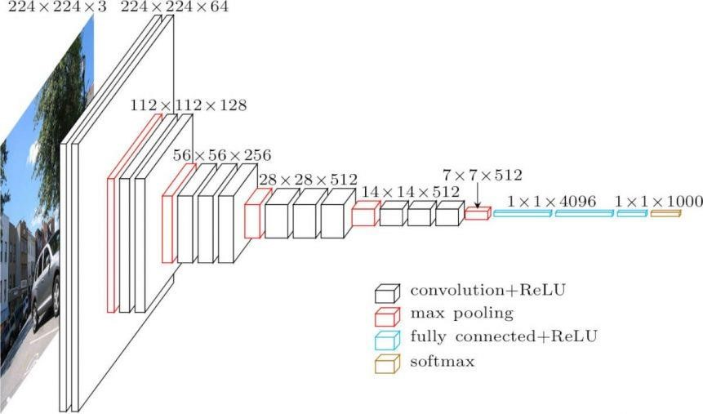
1. RGB ONLY-ARCHITECTURE (VGG16):

Slide 16
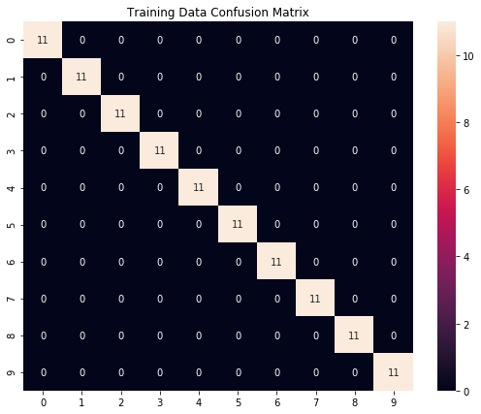
RESULTS OF RGB ONLY Architecture:-

Slide 17
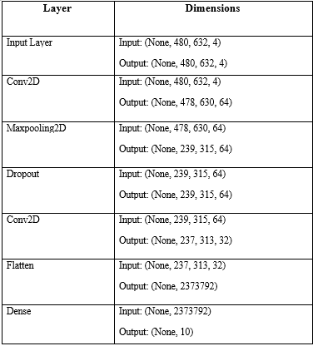
2. RGB+DEPTH NETWORK ARCHITECTURE

Slide 18
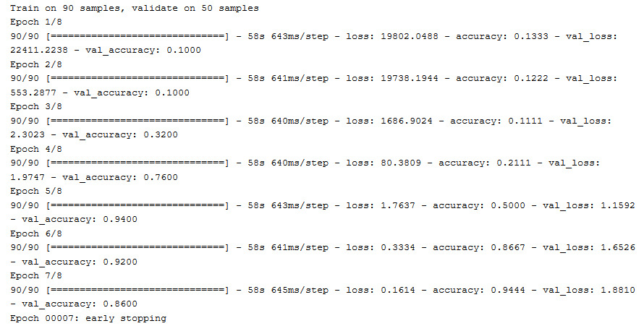

Slide 19
RESULTS OF RGB AND DEPTH IMAGES AS COMBINED ENTITY:-
In order to avoid the previously stated overfitting problem, with this data we have applied early stopping technique to tackle the problem.
We also include additional metrics which give us detailed insights of the model performance.

Slide 20
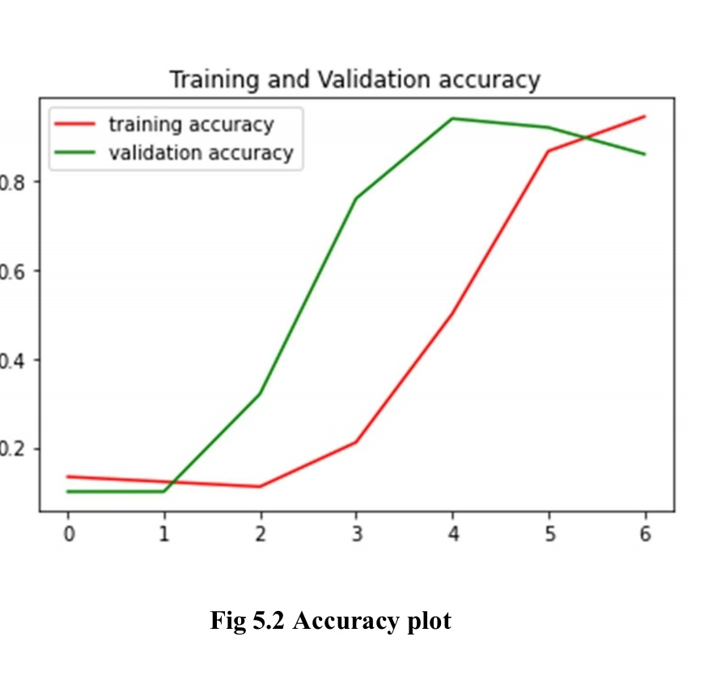
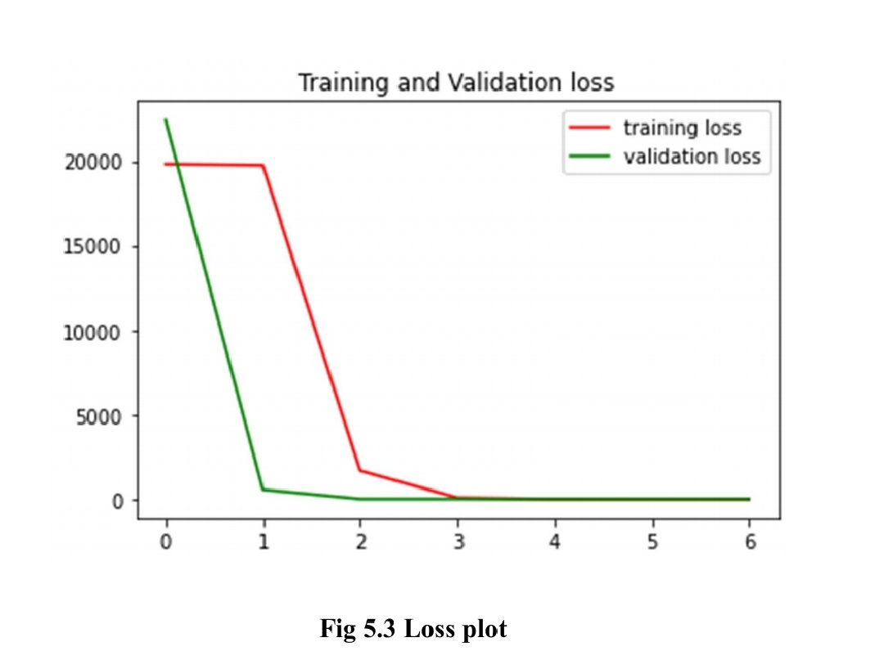
a. accuracy & loss:-

Slide 21
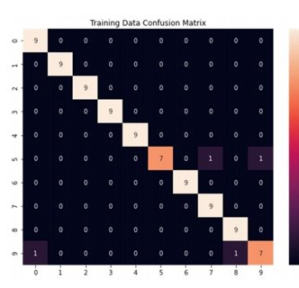
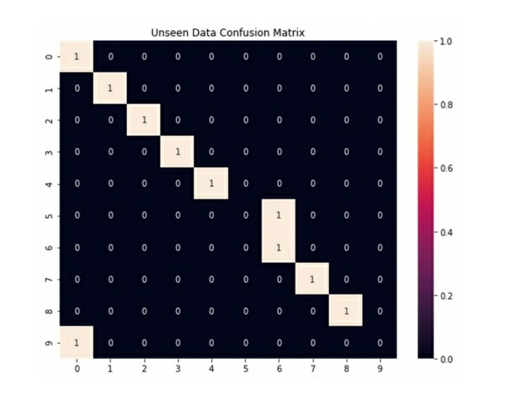
B. CONFUSION MATRIX :-

Slide 22
conclusion
We aimed to solve the problem of hand sign detection and have presented a way of analyzing RGB and Depth information separately and how they can be used in combination to build a robust Hand sign detection system.
The approach includes both the conventional and non-conventional methods which pave way for next generation human and computer interactions.
SCOPE FOR FUTURE WORK:-
• Can be extended to a real-time recognition system by synchronizing RGB and depth frames.
• Applications in 3D Modelling systems.
• Application in the field of Virtual Reality and gaming fields.

Slide 23


Thank You!

